Slide 1
How to reveal neuro-computational mechanisms of reinforcement learning & decision-making?
It is easy to do with the hBayesDM package
Woo-Young Ahn
PI, Computational Clinical Science Lab
Department of Psychology
Ohio State University

Slide 2
Reinforcement Learning and
Decision-Making (RLDM)
Computational modeling
Individual differences
Latent processes (& their time course)

Slide 3
Montague et al (2012) Trends in Cog Sci
Model-based fMRI/EEG
e.g., Forstmann & Wagenmakers (2015); O’Doherty et al (2007)
Behrens, Hunt, Rushworth (2009) Science
Notes:
identify brain regions that presumably implement a cognitive process of interest.

Slide 4
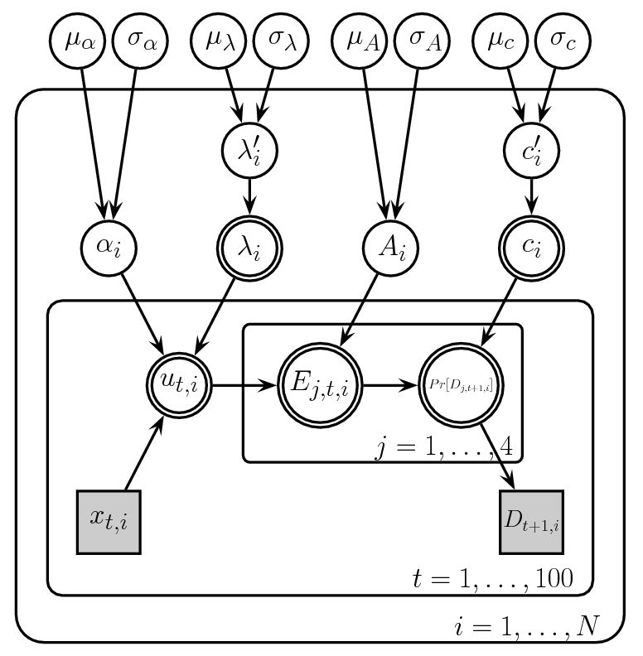
I like the idea of modeling
But…
Mathys et al (2011) Frontiers
Ahn et al (2011) JNPE

Slide 5
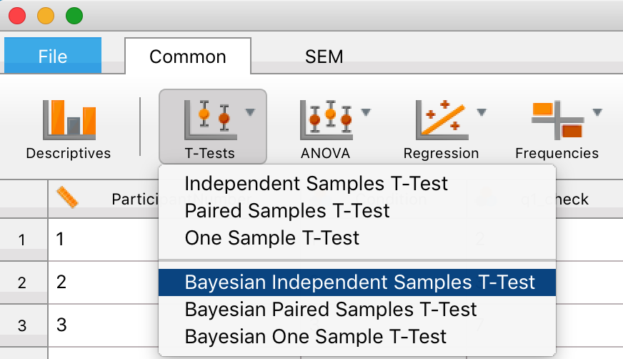
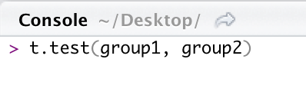
Can we make it easy to do computational modeling?
Q) As easy as doing a T-test?
Several packages exist, but …
JASP, SPSS
R
Matze et al (2013) Frontiers; Wabersich & Vandekerckhove (2014); Wiecki et al (2013) Frontiers;
Daunizeau et al (2014) PLoS Comp Biol
Notes:
JASP is a free alternative software package to SPSS, with which you can do lots of Bayesian statistics with some clicks.

Slide 6
hBayesDM (hierarchical Bayesian modeling of Decision-Making tasks) Package
Models for 8 tasks/paradigms (next slide)
Single-line of coding in R
Model fitting, visualization, model comparisons
Based on the advanced Bayesian software, Stan (https://mc-stan.org).
Hierarchical Bayesian modeling
Ahn et al (2011) JNPE

Slide 7
What tasks and models are available?
- Delay Discounting (e.g., Mazur, 1987)
- Iowa Gambling (Bechara et al, 1994)
- (Orthogonalized) Go/Nogo (Guitart-Masip et al, 2012)
- Two-choice Bandit (Experience-based) including Reversal Learning (e.g., Erev et al, 2010)
Two-choice Description-based
(e.g., Sokol-Hessner et al, 2009; Tom et al, 2007)
- Ultimatum Game (e.g., Xiang et al, 2013)
- *Two-Step (Daw et al, 2011)
Ahn & Busemeyer (2016) Curr Opin Behav Sci
*Version 2.3.0 or later

Slide 8
How can I use it?
Tutorials available at
http://rpubs.com/CCSL/hBayesDM
(you can find it by Googling ‘hBayesDM’)
Install it just like other R packages

Slide 9
Brief step-by-step tutorials
Prepare raw (trial-by-trial) data
Fit candidate models
Plot (visualize) and inspect model parameters
Compare models (if there exist competing models)
The Orthogonalized Go/Nogo task
gng_m1
gng_m2
gng_m3
gng_m4
Guitart-Masip et al, 2012 Neuroimage
Cavanagh et al, 2013 J Neuro

Slide 10
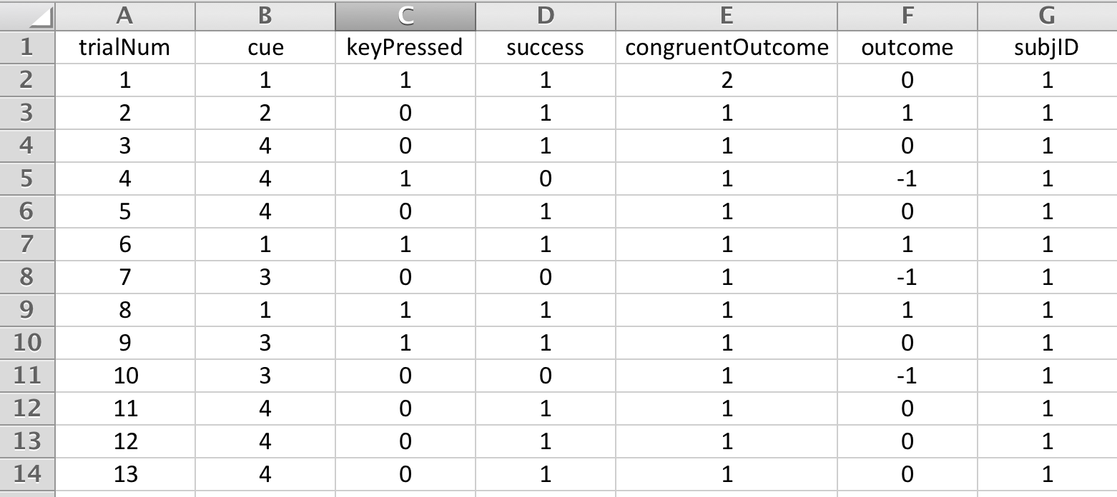
Prepare raw (trial-by-trial) data as a single text file

Slide 11
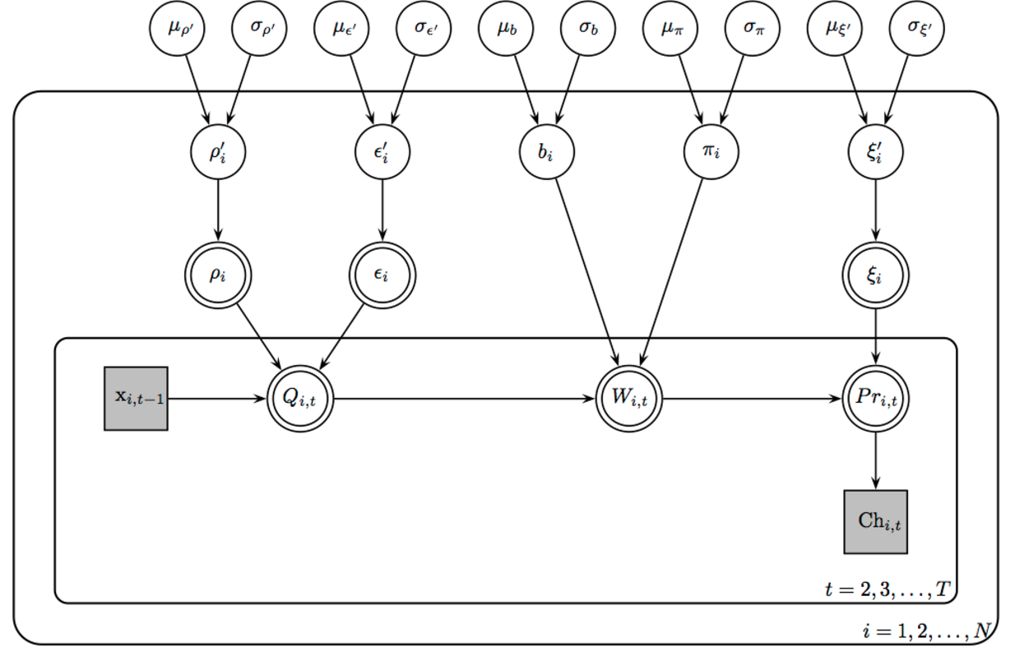
2. Fit candidate models
output1=gng_m1()

Slide 12
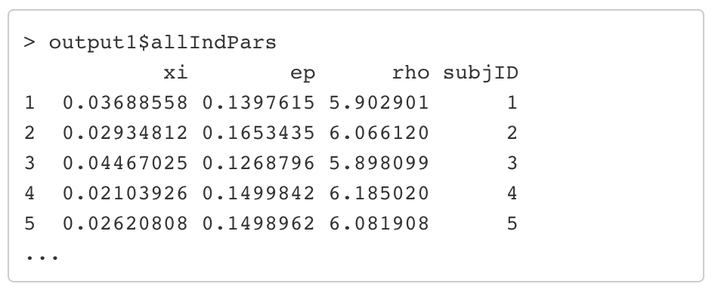
3. Plot (visualize) and inspect model parameters

Slide 13
4. Bayesian model comparisons
Leave-One-Out Information Criterion (LOOIC) - default
Widely Applicable Information Criterion (WAIC)
Vehtari et al. (2016)
Model #4 is the best model
(in terms of LOOIC)

Slide 14
More features!
Bayesian group comparisons
*Model-based regressors (e.g., trial-by-trial prediction errors) for model-based fMRI/EEG
More tasks / models!

Slide 15
I don’t have much quantitative background, can I still do computational modeling?
Yes! Please check our tutorials/poster available @ http://rpubs.com/CCSL/hBayesDM
GitHub: https://github.com/CCS-Lab/hBayesDM

Slide 16
Can I add more models? Can you add more features? Can I contribute?
Yes! hBayesDM is also for experts. It is a work in progress. Please let us know if you have needs or cool models!

Slide 17
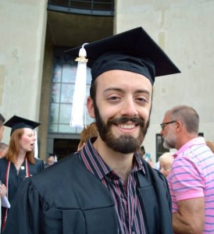
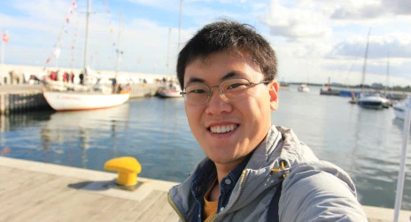
Thank you!
Lei Zhang
University Medical Center Hamburg-Eppendorf
Hamburg, Germany
Nate Haines
The Ohio State University
Ahn, W.-Y., Haines, N., & Zhang, L. (2016). Revealing neuro-computational mechanisms of reinforcement learning and decision-making with the hBayesDM package. bioRxiv. http://doi.org/10.1101/064287

Slide 18
Extra slides

Slide 19
Plan for model-based fMRI with hierarchical Bayesian estimation
Trial-by-trial performance
Computational model
Hierarchical Bayesian estimation
Parameter estimates
Time courses of mental processes
Brain activations
General Linear Model estimation
Brain regions whose activity correlates with mental processes

